Slide 1
POSTGRESQL fAHRİ KAAN GÖKTUNA https://github.com/fahrigoktuna/AcikSeminer_20.05.2019 fahrıgoktuna@gmaıl.com

Slide 2
Content
PostgreSQL Architecture of Running
- Server Processor (Postmaster)
- Shared Buffers
- WAL (Write Ahead Logging)
- bgwriter & Checkpointers
PostgreSQL Performance Tips
- explain, analyze, vacuum
- pg_stats_statement
- Indexes
PostgreSQL Procedural Languages
- pl_python example
PostgreSQL Extensions
PostgreSQL Transactions
PostgreSQL Migrations

Slide 3
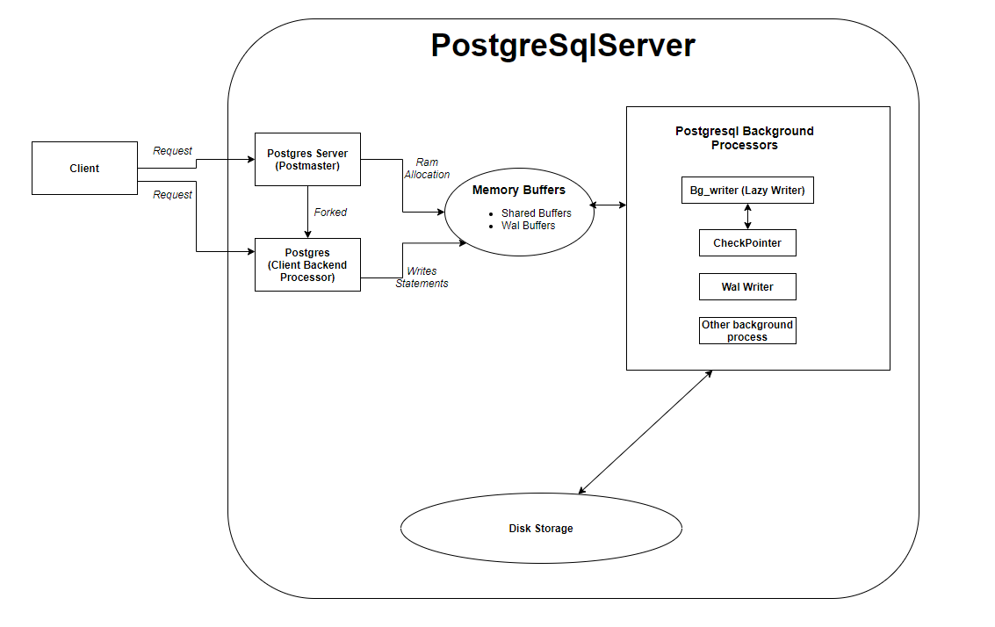
PostgreSQL Architecture of Running

Slide 4
PostgreSQL Server Processor (Postmaster)
PostgreSql Server Main Background Process
Allocation memory for postgresql server
Fork (postgres) - backend processes - for clients
Configurations
-hostname
-port
-max-connections
-nbuffers
-shared_buffers
Configurations needs to be restart server to refresh.

Slide 5
PostgreSQL Shared Buffers
Data writen and read from this memory allocated parts
Dirty Data(Pages)
Bg_writer and checkpointers = [shared buffer data => data disk.]
Required memory locked by Postgres.

Slide 6
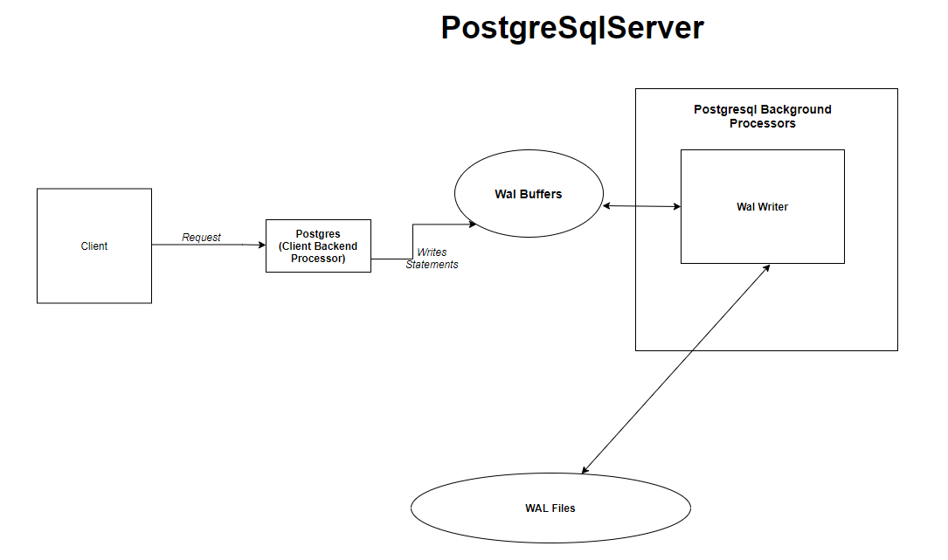
PostgreSQL WAL
Transactions written to WAL Buffers.
Important for data integrity and performance.
Postgresql instance restore
itself by using Wal files.
Transaction Logs files much less cost than flusing the data pages.

Slide 7
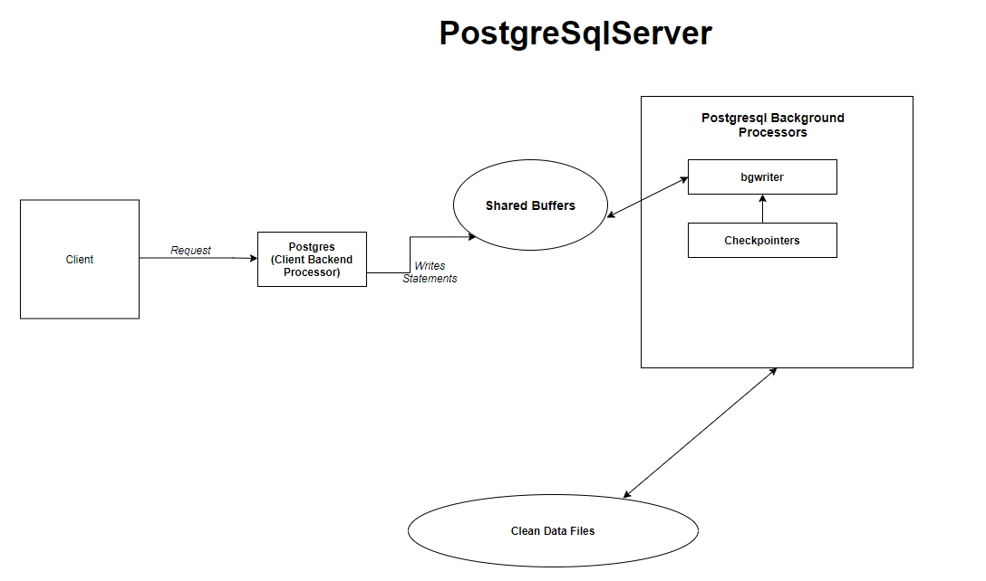
PostgreSQL bgwriter & Checkpointers
Responsible to flush shared buffers to disk.
Dirty paged handle by bgwriter once checkpoint alert bgwriter.
Shared Buffers clean by bgwriter according to
LRU Algorithm.
If Shared Buffers size full then bgwriter clean buffer according to LRU buffers.

Slide 8
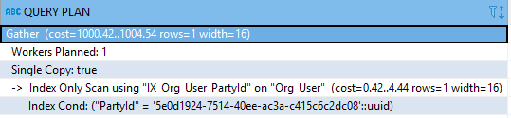
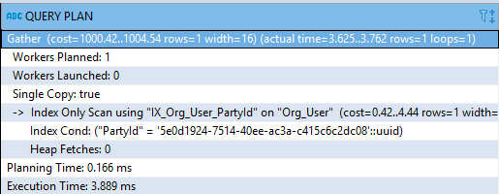
PostgreSQL explain
Postgres «Parse» , «Plan» , «Execute» statements.
Given «explain» keyword to show planned query plan.
Given «explain» «analyze» keyword to show actual query plan.

Slide 9
PostgreSQL analyze
«analyze» «table» statement for postgres to collect table statistics
pg_statistic show updated latest contents of a table.
Query planner uses those statistics to create most efficient query plan.
«analyze» statement collect statistics for all tables in current database.
When significant amount of data insert,update or delete in other words
changed or before and after adding or removing index running analyze table is important to collect correct statistics to build correct query plans.
Analyzing table or columns does not hold exclusive lock on table so you can continue to select table

Slide 10
PostgreSQL vacuum
Reclaim data space to postgres.
By default postgres «AutoVacuum» deamon is enabled.
«Vacuum Full» reclaim data both memory space and disk space.
«Vacuum Full» create same size of an existing table then removes dead tuples.
«Vacuum Full» hold exclusive lock on table. Slower, need free disk space, can not access table while progress on going.
Analyze tables after running vacuum progress to collect updated table statistics.
«Autovacuum» maintains vacuum + analyze process by default in postgres.

Slide 11
PostgreSQL pg_stat_statements
By default exists in contrib library on postgresql source code.
Need to create to enable on each database
«Create extension pg_stat_statements»
Collects which statements that are run on postgres.
min, max, average execution times,
how many rows hitted,
how many times,
which database & which user.

Slide 12
PostgreSQL indexes – Index Types
B-tree, Hash, GiST, GIN are index types used for different algorithm.
By default postgres create indexes as B-tree.
B-tree balanced tree algorithm. Can be useful for null checks, «<», «<=», «>», «>=» operators.
Hash indexes only can be useful = operatör – equality comparisons-
GIN indexes can be useful when to benefit of full text search capabilities.
GiST index useful geometric data types, range comparisons.

Slide 13
PostgreSQL Indexes
Partial (Conditonal) Indexes Efficient to reduce index size & index hit performance
«CREATE INDEX index_name on table_name where column_name is null»
Unique indexes efficient for data integrity & query performance.
A unique index guarantees that the table won’t have more than one row with the same value. It’s advantageous to create unique indexes for two reasons: data integrity and performance. Lookups on a unique index are generally very fast.
Covering indexes efficient to store indexes with possibly gattering values.
CREATE UNIQUE INDEX index_name ON table_name(column_name) INCLUDE (another_column_Name);

Slide 14
PostgreSQL Index Hits
«Explain» «your_query» can Show query plan for your statement.
Index only scan data gathering from index stores not from tables.
Index scan data gathering wtih the help of index with table look up.

Slide 15
PostgreSQL Index Hits
Postgres query planner determines whether index can be used or not.
You can not force postgres to use index.
Remove mishitted indexes for better performance.
Do not create lots of indexes. Decrease insert/update/delete performance.
Shared_buffers can not be large enough to store all indexes. So statements hits the disk.
pg_stat_user_indexes used for index statistics.

Slide 16


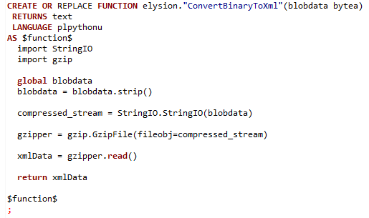

PostgreSQL Procedural Languages

Slide 17



PostgreSQL Transaction
PostgreSQL Transaction Management
PostgreSQL Isolation Levels
Isolation Level | Dirty Read | Nonrepeatable Read | Phantom Read | Serialization Anomaly
Read uncommitted | Allowed, but not in PG | Possible | Possible | Possible
Read committed | Not possible | Possible | Possible | Possible
Repeatable read | Not possible | Not possible | Allowed, but not in PG | Possible
Serializable | Not possible | Not possible | Not possible | Not possible

Slide 18




PostgreSQL Data Migration
SSIS Packages (Data Migration)
PostgreSQL

Slide 19


